Slide 1
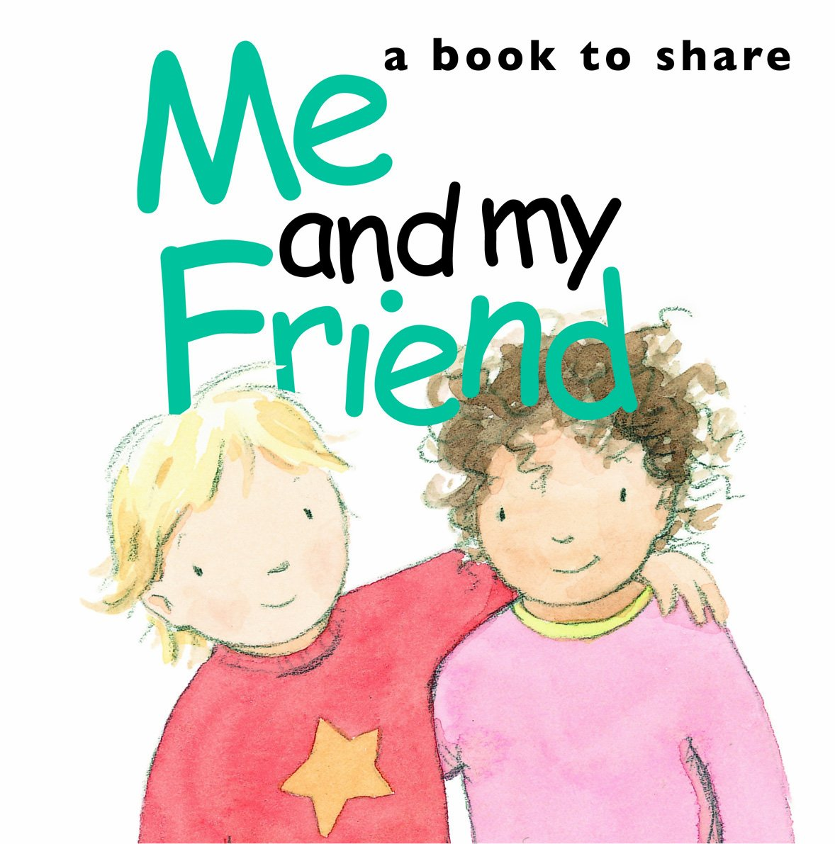
Wednesday, November 3rd, 2021
Unit 3. My Friends
Lesson 4. Communication

Slide 2







UNIT 3: MY FRIENDS
Everyday English
Date of birth and personality
Listen and read the dialogue between Linda and Mi. Pay attention to the highlighted.
Read about these students in 4Teen magazine. Use one or two adjectives to describe them.
Work with a classmate. Ask him / her about his / her best friend. Remember to use the two questions highlighted in 1.
We may have different personalities because we have different birthdays.
Read the descriptions below. Do you think they match the friends in 3?
Read the descriptions in 4.
Share your opinion with the class.

Slide 3


Unit 3: My friend
Lesson 4: communication
Listen and read the dialogue between Linda and Mi. Pay attention to the highlighted.
Linda: What does your best friend look like?
Mi: She’s short with long black hair.
She has bright brown eyes.
Linda: What’s she like?
Mi: She’s very kind and creative.
…

Slide 4
Wednesday, October 20th, 2021
Unit 3. My Friends
Lesson 4. Communication
Everyday English
1. Asking about appearance and personality.
a. Asking about appearance.
What + do/ does + S + look like?
S + have/ has + (a/ an) + adj. + body part
Ex: What does your best friend look like?
She has blue eyes.
b. Asking about personality.
What + to be + S + like?
S+ to be + adj.
Ex: What is she like?
She is very kind and creative.

Slide 5

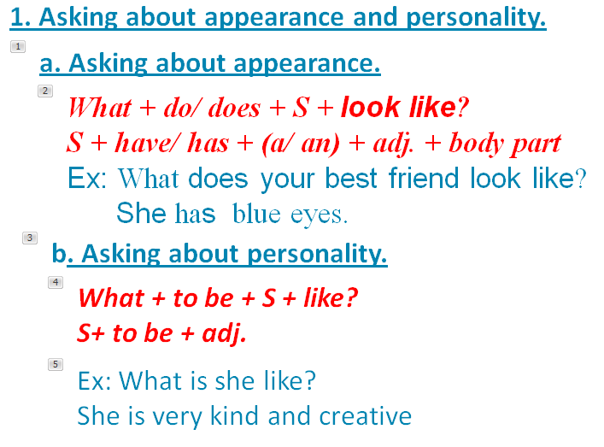
Work with a classmate. Ask him / her about his / her best friend. Remember to use the two questions highlighted in 1.
Linda: What does your best friend look like?
Mi: She’s short with long black hair.
She has bright brown eyes.
Linda: What’s she like?
Mi: She’s very kind and creative.

Slide 6

Date of birth and personality

Slide 7

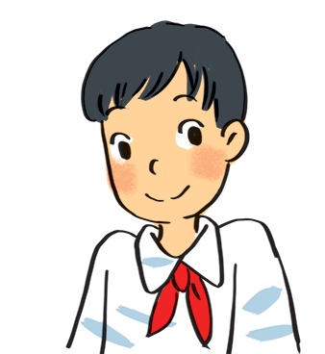
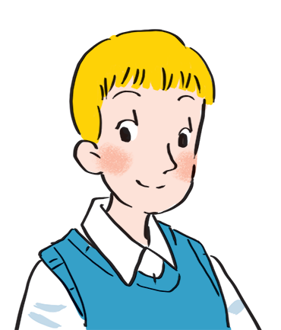
Read about these students in 4Teen magazine. Use one or two adjectives to describe them.
clever
I live in Da Nang. At home, I can do my homework without my parents’ help. At school, I like speaking English. I’m going to an English club now.
hard-working
I come from Cambridge. In my free time, I draw pictures and play the piano. I also help some old people near my house. I usually read to them at the weekend. Now I’m drawing in my garden.
creative
kind
Notes:
City landmarks phải ở trên mục 3

Slide 8

We may have different personalities because we have different birthdays.
Read the descriptions below. Do you think they match the friends in 3?
21/3 – 19/4 | confident, active
20/4 – 20/5 | loving, hard-working
21/5 – 21/6 | active, friendly
22/6 – 22/7 | caring, clever
23/7 – 22/8 | confident, creative
23/8 – 22/9 | careful, hard-working
23/9 – 23/10 | creative, friendly
24/10 – 21/11 | careful, funny
22/11 – 21/12 | clever, confident
22/12 – 19/1 | careful, hard-working
20/1 – 18/2 | friendly, clever
19/2 – 20/3 | kind, creative

Slide 9

Homework
Do activity 4,5 in the workbook
Prepare new lesson Unit 3. Skills 1

Slide 10



Read the descriptions in 4.
Share your opinion with the class.
Example:
My birthday is …
It’s true that …
It isn’t true that …

